Slide 1
Direct and Inverse Variation:
MATH A104
Megan Gobeille
UAA

Slide 2
Direct vs Inverse Variation
Direct Variation
Inverse Variation
The ratio of two variables is a constant
The product of two variables is constant

Slide 3
Direct vs Inverse Variation
Direct Variation
Inverse Variation
The ratio of two variables is a constant
Examples:
ratio of feet to inches
Scale on a map
How many cookies I can make with how much dough I have
The product of two variables is constant
Examples:
Pulley system
Gears
Lever arms
Window washing time for number of people

Slide 4


Direct vs Inverse Variation
Direct Variation
Inverse Variation
The ratio of two variables is a constant
Our book: $\frac{y_{1}}{x_{1}}=\frac{y_{2}}{x_{2}}$
The product of two variables is constant
Our book: $\frac{y_{1}}{y_{2}}=\frac{x_{2}}{x_{1}}$ or $x_{1}y_{1}=x_{2}y_{2}$

Slide 5
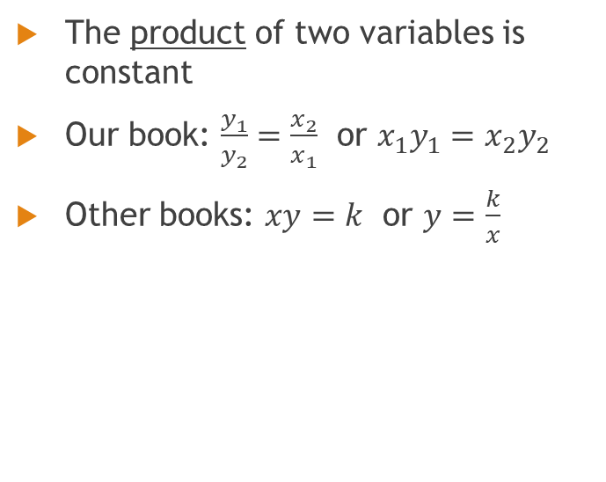

Direct vs Inverse Variation
Direct Variation
Inverse Variation
The ratio of two variables is a constant
Our book: $\frac{y_{1}}{x_{1}}=\frac{y_{2}}{x_{2}}$
Other books: $\frac{y}{x}=k$ or $y=kx$
The product of two variables is constant
Our book: $\frac{y_{1}}{y_{2}}=\frac{x_{2}}{x_{1}}$ or $x_{1}y_{1}=x_{2}y_{2}$
Other books: $xy=k$ or $y=\frac{k}{x}$

Slide 6
Direct vs Inverse Variation
Direct Variation
Inverse Variation
The ratio of two variables is a constant
Our book: $\frac{y_{1}}{x_{1}}=\frac{y_{2}}{x_{2}}$
Other books: $\frac{y}{x}=k$ or $y=kx$
The product of two variables is constant
Our book: $\frac{y_{1}}{y_{2}}=\frac{x_{2}}{x_{1}}$ or $x_{1}y_{1}=x_{2}y_{2}$
Other books: $xy=k$ or $y=\frac{k}{x}$
What would this look like if we graphed it?
What would this look like if we graphed it?

Slide 7
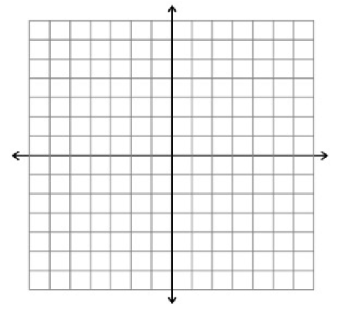


Direct vs Inverse Variation
Direct Variation
Inverse Variation
$y=kx$
$y=\frac{k}{x}$

Slide 8
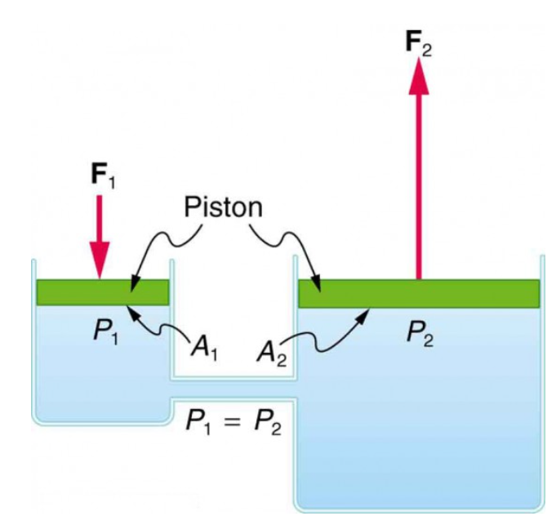
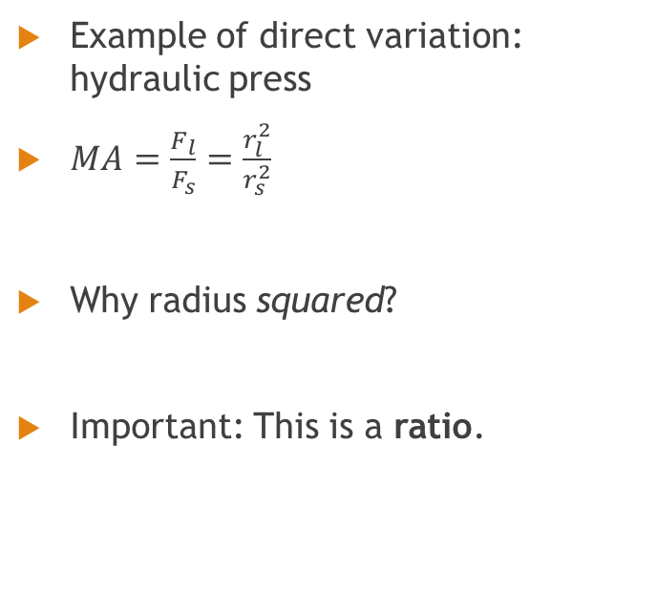
Direct Variation
Example of direct variation: hydraulic press
$MA=\frac{F_{l}}{F_{s}}=\frac{r_{l}^{2}}{r_{s}^{2}}$
Why radius squared?
Important: This is a ratio.
Taken from lumenlearning.com

Slide 9

Direct Variation
Example of direct variation: hydraulic press
$MA=\frac{F_{l}}{F_{s}}=\frac{r_{l}^{2}}{r_{s}^{2}}$
A force of 8,100 lb is exerted by a piston of radius 30 in of a hydraulic press. What force was applied to its piston of radius 3 in?

Slide 10

Inverse Variation
Pulleys, gears, and lever arms (see saws) all operate as inverse variation.
Inverse variation is $x_{1}y_{1}=x_{2}y_{2}$
The product is a constant.

Slide 11

Inverse Variation
Pulleys, gears, and lever arms (see saws) all operate as inverse variation.
Inverse variation is $x_{1}y_{1}=x_{2}y_{2}$
The product is a constant.
Example: A large gear with 80 teeth turning at a rate of 150 rpm turns a small gear with 12 teeth. At how many rpm does the small gear turn?

Slide 12
Inverse Variation
Frequently inverse variation problems follow the same pattern:
Product of two elements in thing 1 = product of same two elements in thing 2

Slide 13
Inverse Variation
Every inverse variation problem in the homework follows the same pattern:
Product of two elements in thing 1 = product of same two elements in thing 2
Pulley: (diameter of pulley A)(rpm of pulley A) = (diameter of pulley B)(rpm of pulley B)

Slide 14
Inverse Variation
Every inverse variation problem in the homework follows the same pattern:
Product of two elements in thing 1 = product of same two elements in thing 2
Pulley: (diameter of pulley A)(rpm of pulley A) = (diameter of pulley B)(rpm of pulley B)
Gear: (number of teeth A)(rpm A) = (no. of teeth B)(rpm B)

Slide 15
Inverse Variation
Every inverse variation problem in the homework follows the same pattern:
Product of two elements in thing 1 = product of same two elements in thing 2
Pulley: (diameter of pulley A)(rpm of pulley A) = (diameter of pulley B)(rpm of pulley B)
Gear: (number of teeth A)(rpm A) = (no. of teeth B)(rpm B)
Lever: (force on side A)(distance from fulcrum) = (force on side B)(distance from fulcrum)

Slide 16
Inverse Variation
Every inverse variation problem in the homework follows the same pattern:
Product of two elements in thing 1 = product of same two elements in thing 2
Pulley: (diameter of pulley A)(rpm of pulley A) = (diameter of pulley B)(rpm of pulley B)
Gear: (number of teeth A)(rpm A) = (no. of teeth B)(rpm B)
Lever: (force on side A)(distance from fulcrum) = (force on side B)(distance from fulcrum)
I do expect you to be able to identify pulley/gear/lever problems as inverse variation

Slide 17
Inverse Variation:
Example: A 1200 g mass is placed 72 cm from the fulcrum of a lever. How far from the fulcrum is a 1350 g mass that balances it?

Slide 18
Direct and Inverse variation with a constant of proportionality
Major drawbacks to our book’s method:
Can’t generalize the solution
Harder to see the relationship between the variables
Mathematical modeling
Can’t do more complex problems (joint variation)

Slide 19
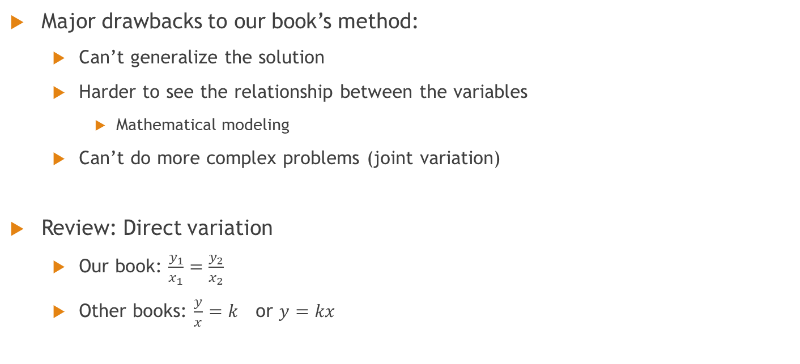
Direct and Inverse variation with a constant of variation
Major drawbacks to our book’s method:
Can’t generalize the solution
Harder to see the relationship between the variables
Mathematical modeling
Can’t do more complex problems (joint variation)
Review: Direct variation
Our book: $\frac{y_{1}}{x_{1}}=\frac{y_{2}}{x_{2}}$
Other books: $\frac{y}{x}=k$ or $y=kx$

Slide 20

Direct and Inverse variation with a constant of variation
Find y when $x=5$ if y varies directly as x and $y=36$ when $x=2$. Also write an equation of variation.

Slide 21
Direct and Inverse variation with a constant of variation
Find the equation of variation when q varies directly as t and q=2 when t = 7.

Slide 22

Direct and Inverse variation with a constant of variation
Inverse variation:
Our book: $\frac{y_{1}}{y_{2}}=\frac{x_{2}}{x_{1}}$ or $x_{1}y_{1}=x_{2}y_{2}$
Other books: $xy=k$ or $y=\frac{k}{x}$
Find r when $t=6$ if $r$ varies inversely as t and $r = 15$ when $t = 3$.

Slide 23
Direct and Inverse variation with a constant of variation
The heat loss through rock wool insulation is inversely proportional to the thickness of the rock wool. If the loss through 6 in of rock wool is 3200 Btu/h, find the loss through 2.5 in of rock wool.

Slide 24
Variation problems with a constant of proportionality (aka constant of variation, aka “k”)
Of course we’re not limited to direct and inverse variation.
How would this work?
S varies directly as the product of xyz
y varies directly as x and inversely as the square of z

Slide 25
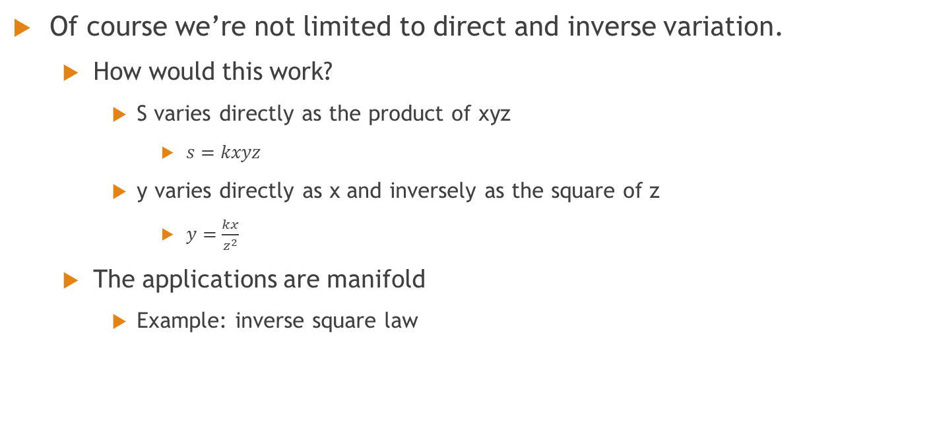
Variation problems with a constant of proportionality (aka constant of variation, aka “k”)
Of course we’re not limited to direct and inverse variation.
How would this work?
S varies directly as the product of xyz
$s=kxyz$
y varies directly as x and inversely as the square of z
$y=\frac{kx}{z^{2}}$
The applications are manifold
Example: inverse square law

Slide 26
Joint variation
The amount Q of water emptied by a pipe varies directly as the square the of the diameter d. A pipe 5 in. in diameter will empty 225 gal of water over a fixed time period. If we assume the same kind of flow, how many gallons of water are emptied in the same amount of time by a pipe that is 9 in. in diameter?

Slide 27
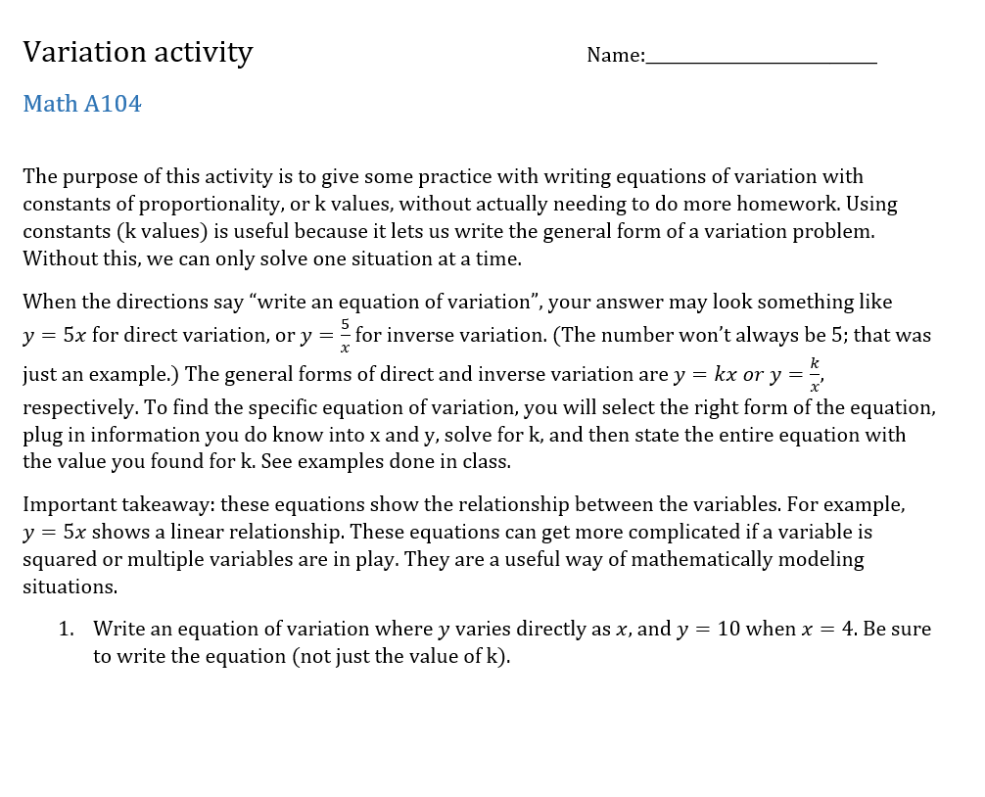
Variation with k

Slide 28
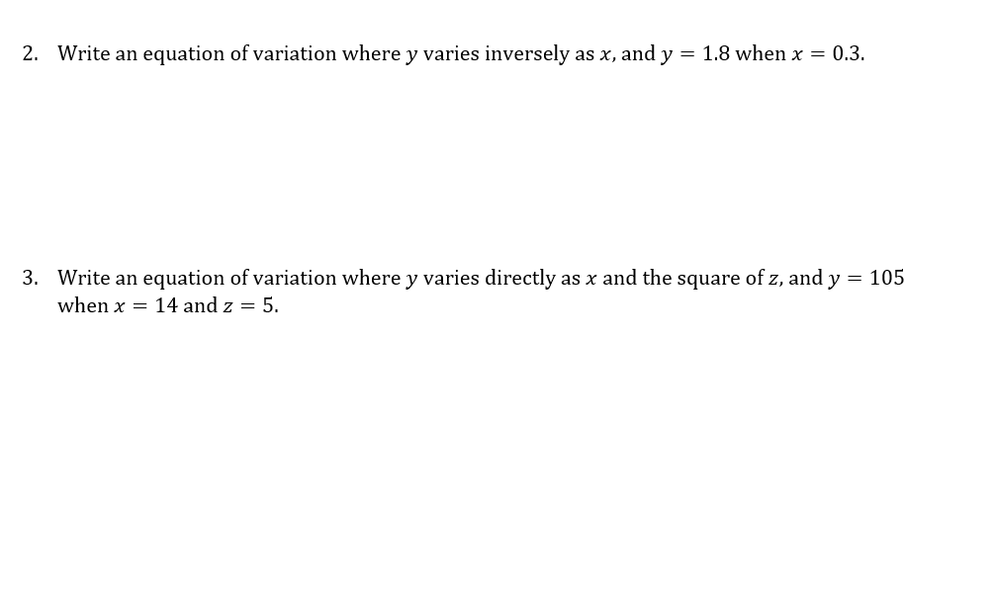
Variation with k

Slide 29
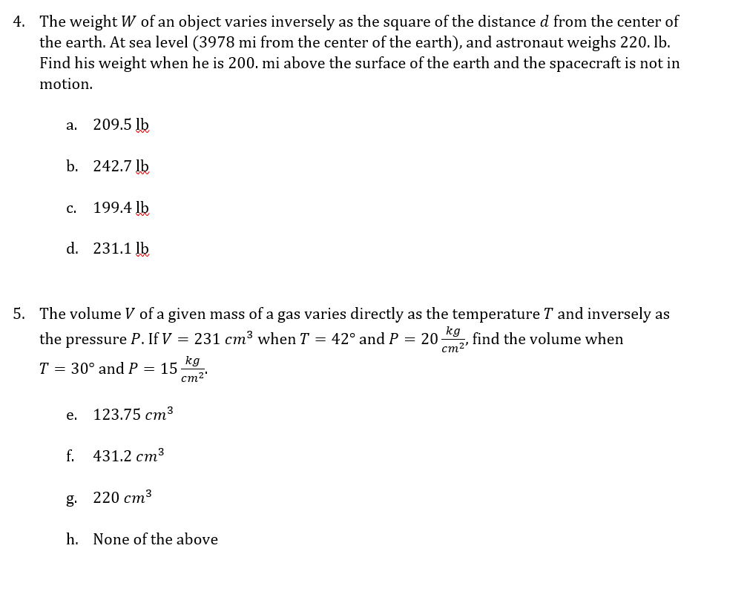
Variation with k

Slide 30

Takeaways
Direct variation is a ratio.
Direct variation is a linear relationship.
Direct variation:
Our book: $\frac{y_{1}}{x_{1}}=\frac{y_{2}}{x_{2}}$
Other books: $\frac{y}{x}=k$ or $y=kx$
Big picture items of direct and inverse variation.
3rd project: Radiation Project

Slide 31
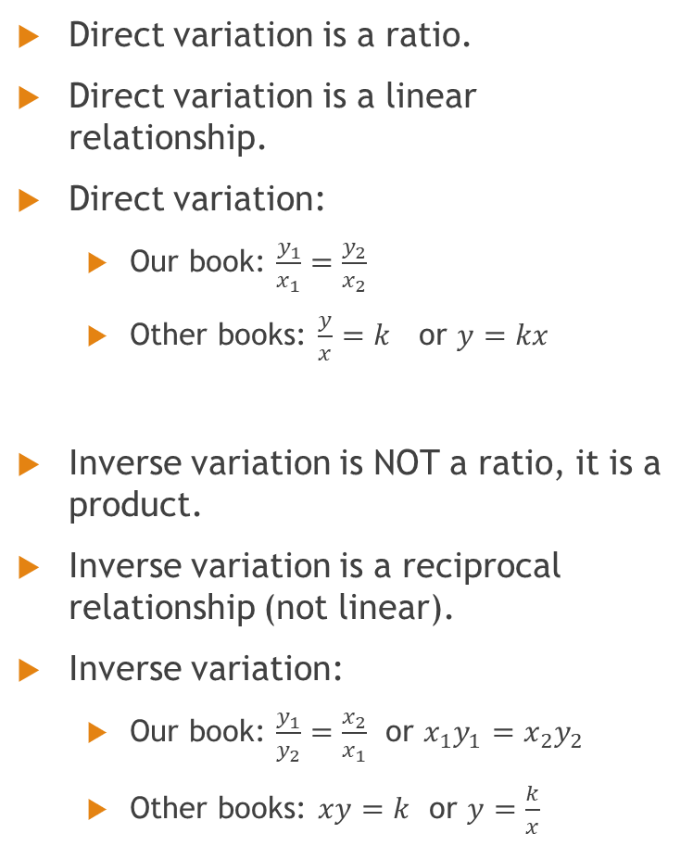
Takeaways
Direct variation is a ratio.
Direct variation is a linear relationship.
Direct variation:
Our book: $\frac{y_{1}}{x_{1}}=\frac{y_{2}}{x_{2}}$
Other books: $\frac{y}{x}=k$ or $y=kx$
Inverse variation is NOT a ratio, it is a product.
Inverse variation is a reciprocal relationship (not linear).
Inverse variation:
Our book: $\frac{y_{1}}{y_{2}}=\frac{x_{2}}{x_{1}}$ or $x_{1}y_{1}=x_{2}y_{2}$
Other books: $xy=k$ or $y=\frac{k}{x}$
Big picture items of direct and inverse variation.

Slide 32
Radiation project
Answers should be consistent.
Example: If you say a relationship is linear, your equation better be direct variation
You will not be able to look up the answers. (Don’t do that anyway for any of the projects.)
You will have to think, and yes I do grade on correctness.
You will be writing equations of variations with constants of proportionality.

